Slide 1
Crowning the Index Champ
Eli Steinbeck
10/7/2021

Slide 2
Project Motivation
Project initially began as an effort to identify the optimal asset allocation mix.
Began wondering how the choice of financial institution impacted performance.
Question: Which financial institution has better performing index funds?
Benefits the individual investor*.
*I am not a financial advisor. This is not investing advice.

Slide 3
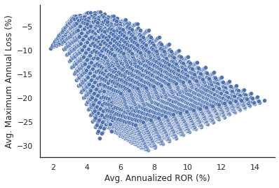
How Will Performance Be Measured?
Two Variables of Interest:
Average Annualized Rate of Return (Who earns the most?)
Average Maximum Annual Loss (Who loses the least?)
Null Hypotheses
$H_{1}$: There is no significant difference in the average annualized returns between financial institutions 1 and 2.
$H_{2}$: There is no significant difference in average maximum annual losses between financial institutions 1 and 2.

Slide 4
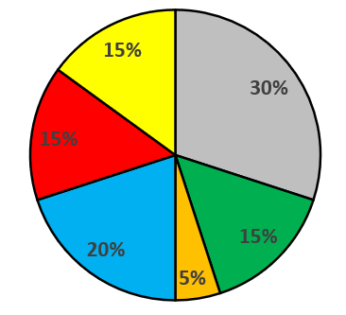




Modeling Workflow
Asset Classes
1. Define Initial Investment Amount
2. Define Asset Allocation
3. Define Investment Period
Domestic Stock
International
Stock
Emerging Markets Stock
5. Calculate Outputs of Interest
Real Estate
4. Calculate Running 365-Day ROR
Bonds
Inflation Protected Securities
6. Repeat for Remaining Asset Allocation Combinations (53130 Total)

Slide 5
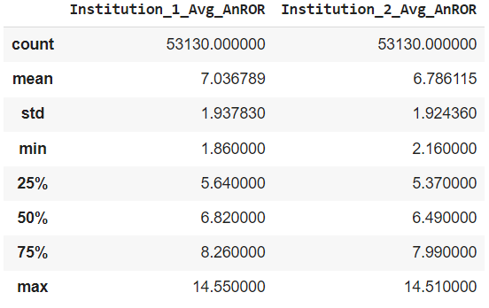
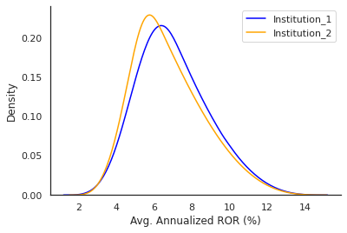
Comparing Average Annualized ROR
Institution 1
Institution 2
Similar range of values for Institution 1 and 2.
Slightly higher average annualized ROR for Institution 1 at 7.04% vs 6.79% for Institution 2.
Is it significant?
t-test Results
Reject null hypothesis 1. Results are significant with p values much less than .05.
With 95% confidence the difference in the means is between 0.23 and 0.27%.

Slide 6
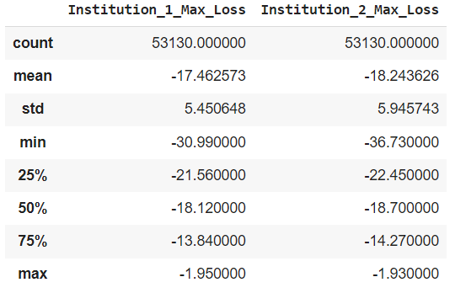
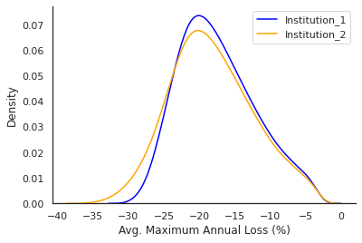
Comparing Average Maximum Annual Loss
Institution 1
Institution 2
Larger range of values for Institution 2.
Slightly higher average maximum annual losses for Institution 2 at -18.24% vs -17.46% for Institution 1.
Is it significant?
t-test Results
Reject null hypothesis 2. Results are significant with p values much less than .05.
With 95% confidence the difference in the means is between 0.71 and 0.85%.

Slide 7
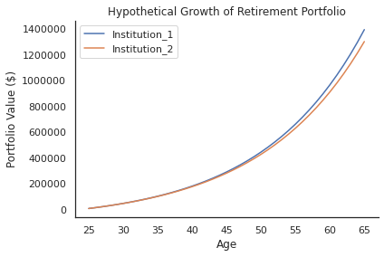
Is it Practically Significant?
Consider a scenario where two individuals begin contributing to a Roth IRA at the age of 25.
Both individuals contribute $6000/year for 40 years until they reach age 65.
One individual invests in an average portfolio of Institution 1 funds; the other invests in an average portfolio of Institution 2 funds.

Slide 8
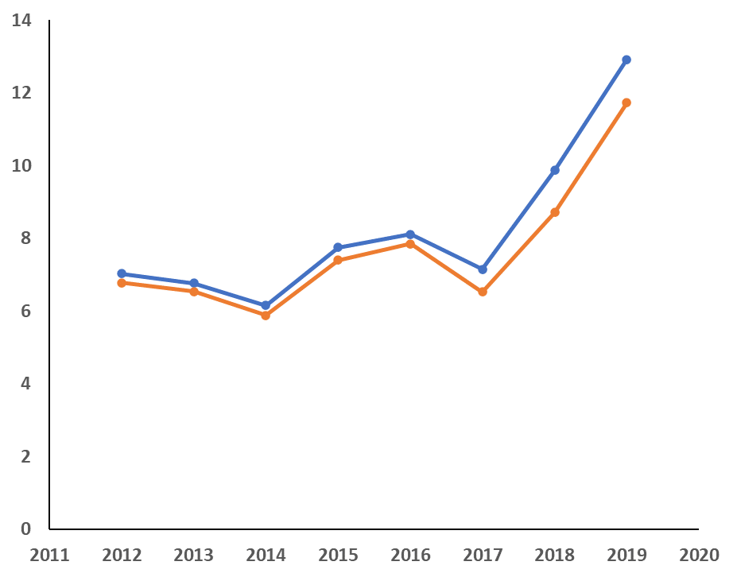
Taking it a Step Further
Are the results being influenced by the age of the funds?
Institution 1 maintains superior performance with time.
Important to note that this analysis does not account expense ratios.
Avg. Annualized ROR (%)
Institution_1
Institution_2
Start of Investing Period

Slide 9
Takeaways
Institution 1 has a stronger performing lineup of index funds in terms of both average annualized rate of return and average maximum annual losses.
In addition to being statistically significant, the difference in performance between institution 1 and 2 proves to be practically significant for long-term investment outcomes.
Recommendation for future work: Extend the analysis to include the impact of expense ratio.
Recommendation for future work: Continue to use this workflow as a tool to identify optimal asset allocation mix.

Slide 10
And just remember…
I am not a financial advisor and as such the results of this analysis should not be considered investing advice.
Historic performance may not be indicative of future results.

Slide 11
Supplemental Material

Slide 12
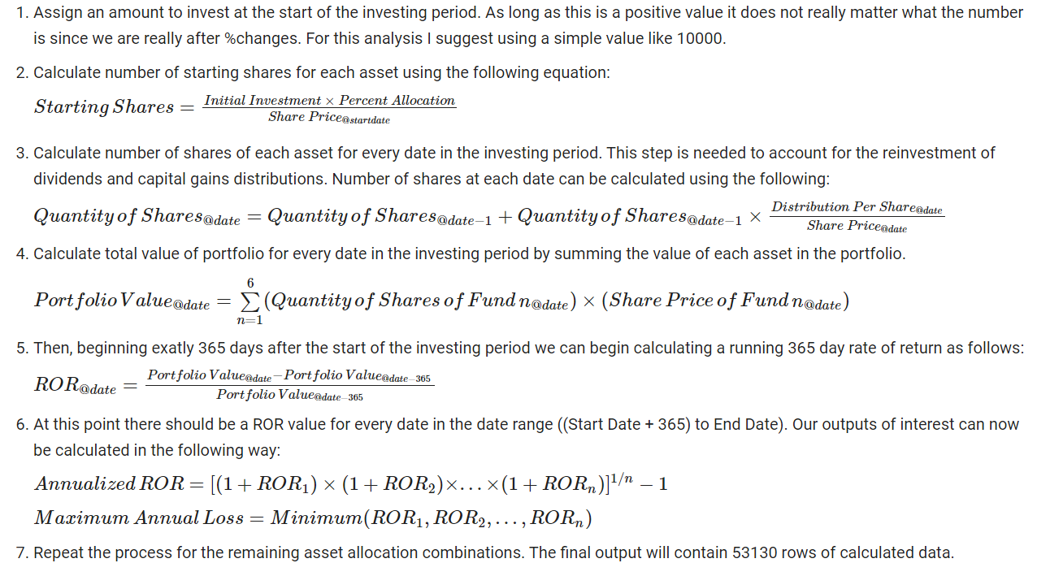
Detailed Workflow

Slide 13
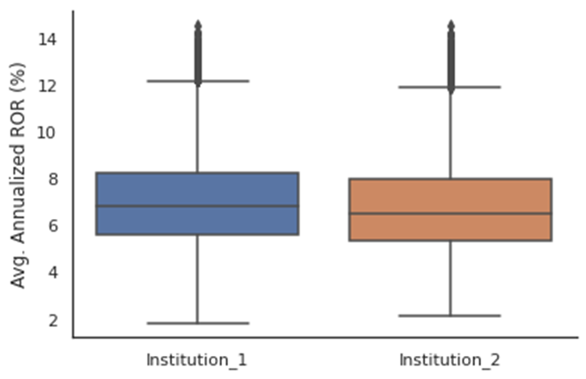
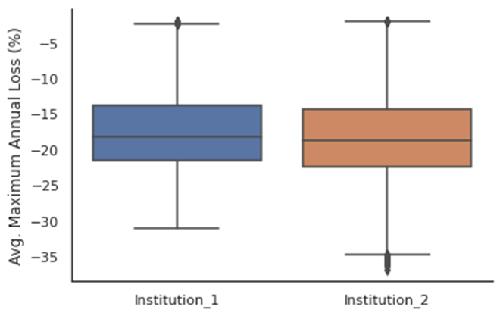
Box Plots

